Slide 1


SAVEETHA SCHOOL OF ENGINEERING DEPARTMENT OF ECE Drainage Monitoring System Using IoT
Name : Sriram Venkata Sai Bharath
Reg no : 191312146
Dept : ECE
Year : IV
Mentor:-
Name : B.Bhuvaneswari (Asst Prof)
Dept : ECE

Slide 2
OUTLINE
Objective
Block Diagram
Implementation(software and hardware)
Coding
Graph
Partial Output
References

Slide 3

Objective:
The Theme of this project is to design a Drainage monitoring System to reduce the effect caused by water logging during floods.

Slide 4
BLOC BlocK Diagram
Processor
cloud
Circuit
Mobile

Slide 5
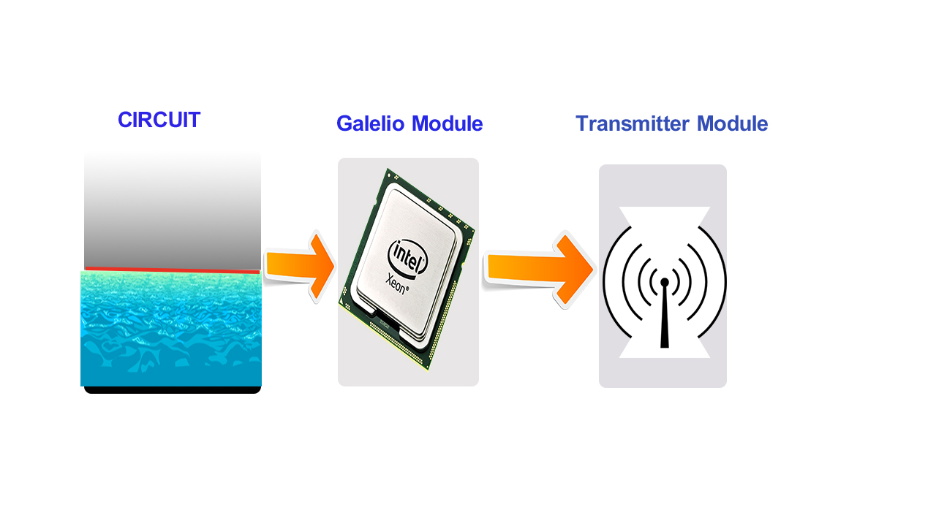
Module-1

Slide 6
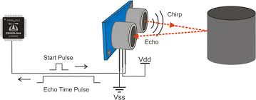
Ultrasonic Sensor
Notes:
Distance L = 1/2 × T × C

Slide 7
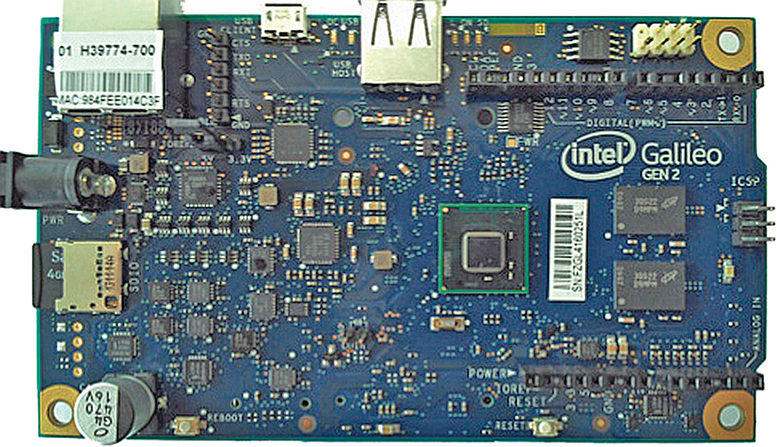
Intel Galelio Gen2

Slide 8
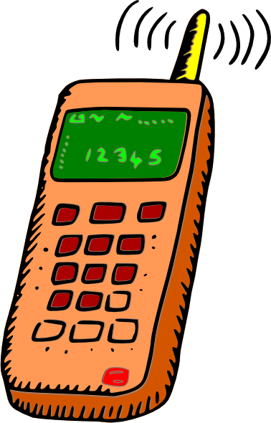
Module-3
cloud
Data import

Slide 9
Implementation
Circuits at different locations will collect information of sewage flow through its nodes and sends data to the central system which will generates an alert prior to complete blockage.
Data base management system
Contains general data obtained from various time instances with which the data received from the circuits will be compared and generate the alerts.

Slide 10
SOFTWARE USED:
Arduino
HARDWARE USED:
Galelio gen2
Wifi module
Gsm shield

Slide 11
Steps
Required changes in the system –
1. Detect the location
2. Prior information of the blockage
Design of SMART DRAINAGE SYSTEM.
System governing the flow of sewage from pipes.
To detect variations in the drainage flow.
Collection of data.
Obtain prior alerts regarding blocks and locate them using IOT

Slide 12
Explanation
Alerts will be generated when the blockage starts developing
Time available to repair the blockage will be enough to prevent the drainage line from completely shutting down.
This technology can be used for all fluid carrying systems. (e.g. Water pipes, gas pipelines)

Slide 13
Program
#include <WiFi.h> #include <SPI.h> // ThingSpeak Settings char thingSpeakAddress[] = "api.thingspeak.com"; //TS String writeAPIKey = "8IAYE5HVTV7US8YT"; //TS int updateThingSpeakInterval = 1 * 1000; // Time interval in milliseconds to update ThingSpeak (number of seconds * 1000 = interval) int status = WL_IDLE_STATUS; // the Wifi radio's status const int analogIn = A0; const int analogIn_1 = A1; int RawValue= 0; int RawValue_1= 0; // initialize the library instance: WiFiClient client; // Variable Setup long lastConnectionTime = 0; boolean lastConnected = false; int failedCounter = 0;

Slide 14
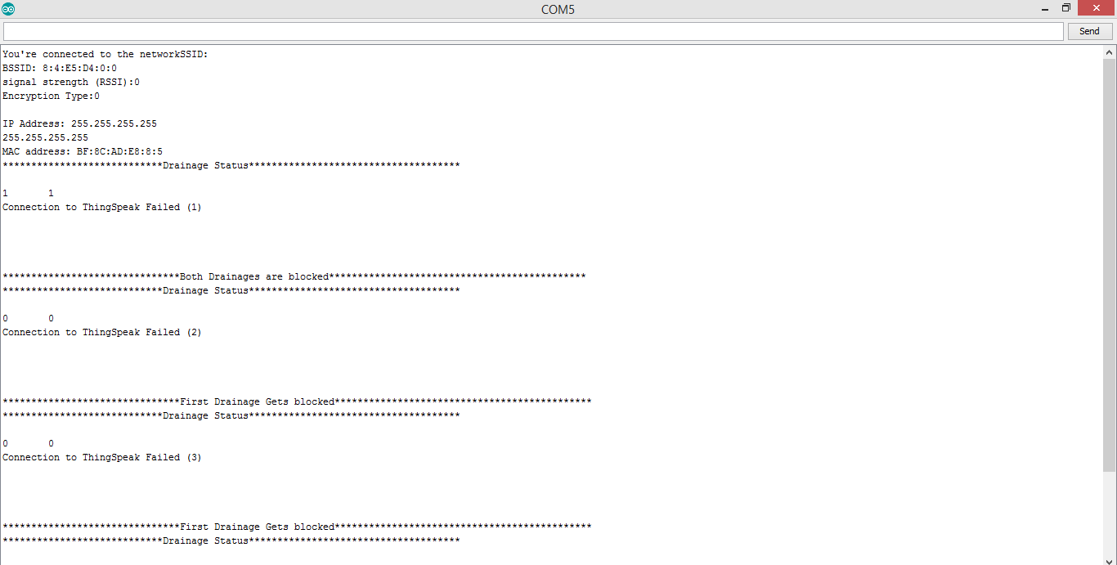
Output

Slide 15
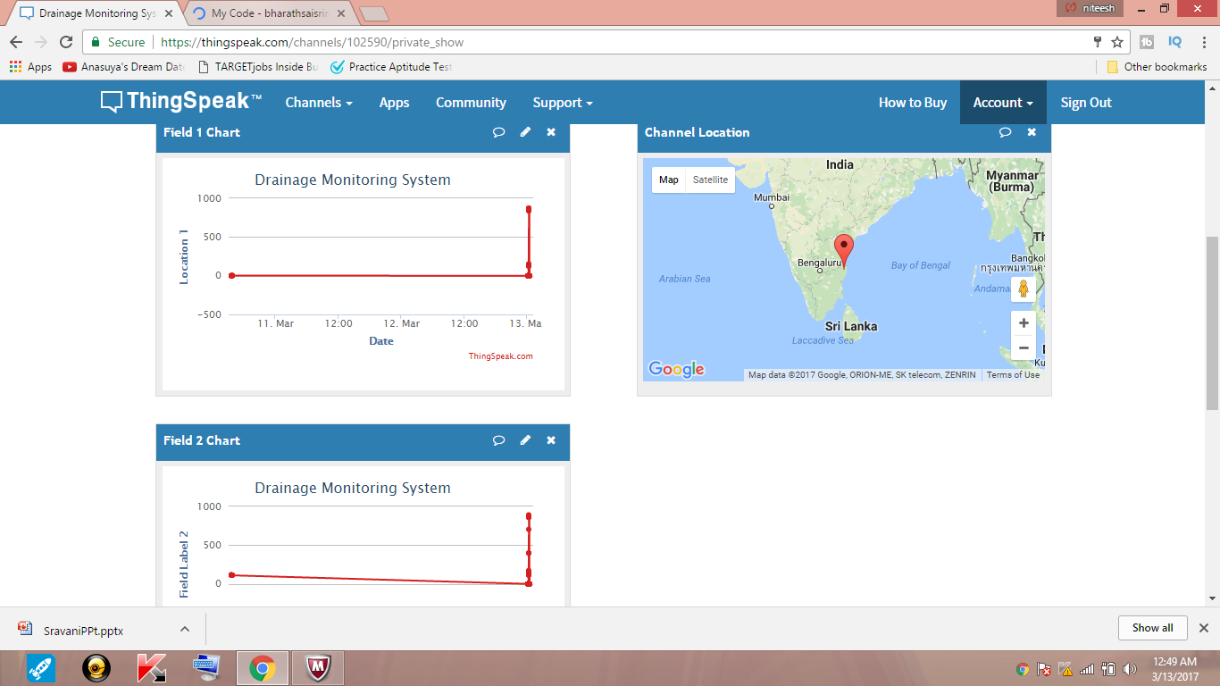
Output

Slide 16
Conclusion
Thus the clogs in the drainage gets identified using these circuit. And the concerned authorities notified from the cloud and GSM.

Slide 17
References
[1] Lazarescu, M.T., "Design of a WSN Platform for Long-Term Environmental Monitoring for IoT Applications," Emerging and Selected Topics in Circuits and Systems, IEEE Journal on , vol.3, no.1, pp.45,54, March 2013.
[2] Kelly, S.D.T.; Suryadevara, N.K.; Mukhopadhyay, S.C., "Towards the Implementation of IoT for Environmental Condition Monitoring in Homes," Sensors Journal, IEEE, vol.13, no.10, pp.3846,3853, Oct. 2013.
[3] Romer, K.; Mattern, F., "The design space of wireless sensor networks," Wireless Communications, IEEE , vol.11, no.6, pp.54,61, Dec. 2004
[4] M. Kuorilehto, M. Kohvakka, J. Suhonen, P. Hmlinen, M. Hnnikinen, and T. D. Hmlinen, Ultra-Low Energy Wireless Sensor Networks in Practice. New York: Wiley, 2007.
[5] K. Romer and F. Mattern, “The design space of wireless sensor networks,” IEEE Wireless Comm., vol. 11, no. 6, pp. 54–61, Dec. 2004.

Slide 18
THANK YOU!!!

